Slide 1


Bring yourself up to speed with PowerShell
Toni Frankola
14 octobre 2017
#SPSParis
Notes:
The PowerShell has been with us since SharePoint 2010 and has substantially evolved over the course of last eight years. In this session, we are going to discuss how PowerShell has evolved to be the most important tool in the IT PROs toolbox. In this session, we are going to discuss the new features that rolled out with PowerShell v5, we are going to learn more about desired state configuration, CredSSP, PowerShell remoting, and PnP PowerShell scripts. On top of that, we are going to spend a fair amount of time discussing some scripts that can help SharePoint admins automate many day-to-day tasks like site provisioning, backups, adding new servers, services and farms.

Slide 2



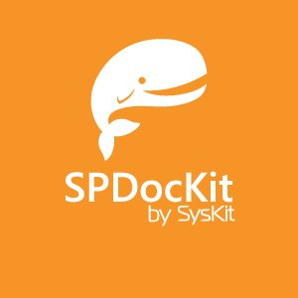













Merci pour votre soutien

Slide 3
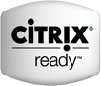


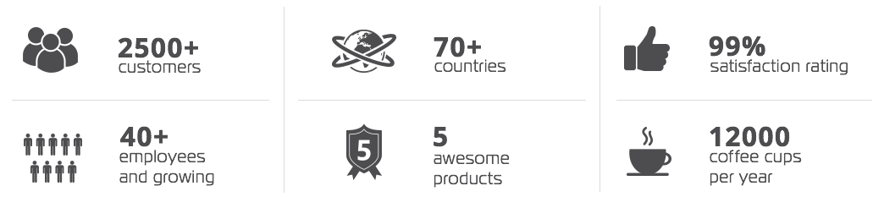
SysKit is a software development company based in Zagreb, Croatia, Europe founded in 2009.
We create innovative software solutions for SharePoint, Office 365, SQL Server, RDS, and Citrix admins and consultants.​
Technology Partners

Slide 4
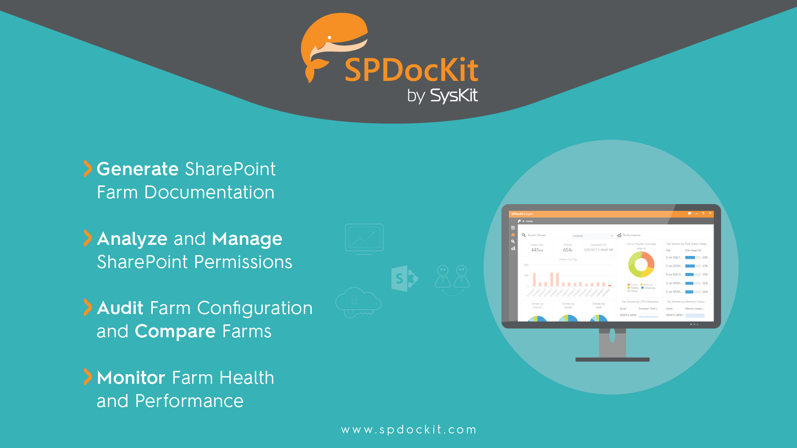

Slide 5

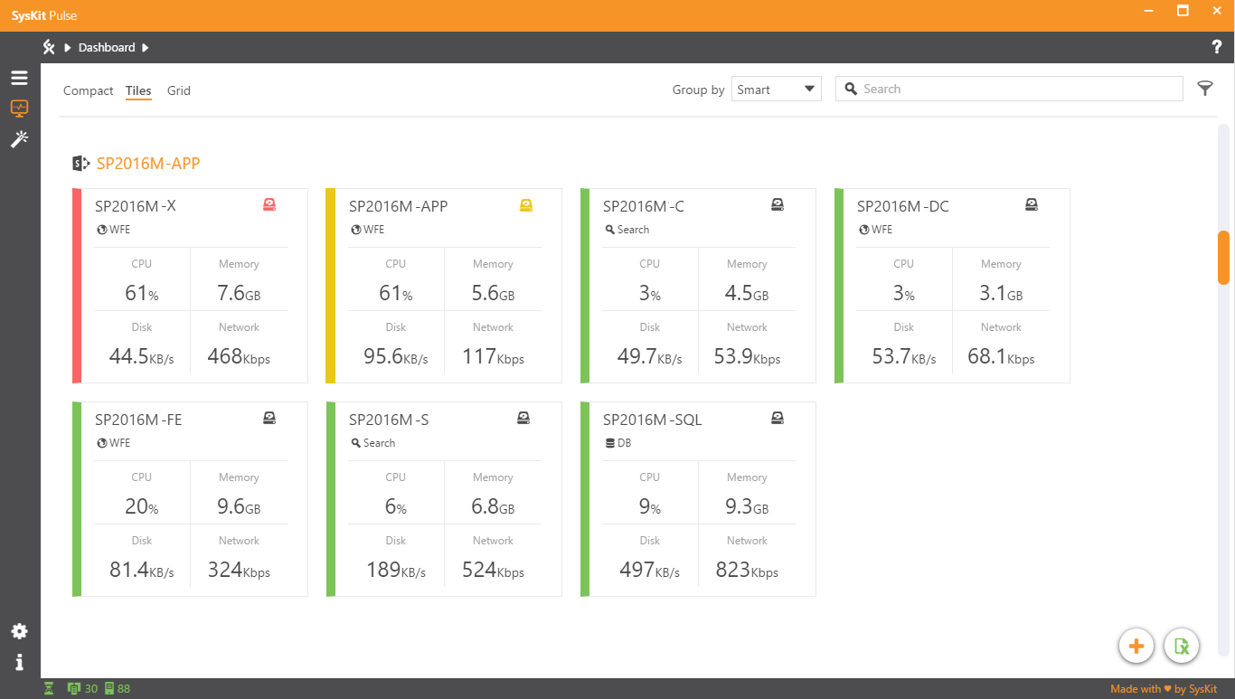
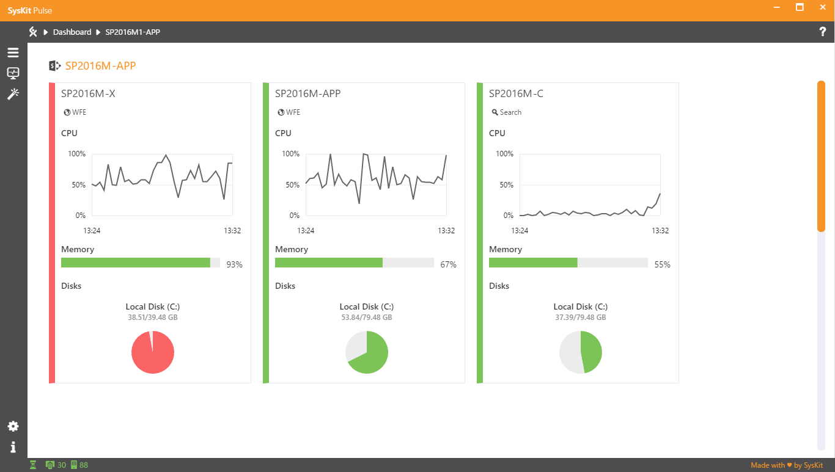
Autodiscover Microsoft SharePoint farms and accompanying servers, as well as Microsoft SQL Servers, in all your domains
Audit the most important performance counters
https://www.syskit.com/products/pulse/

Slide 6

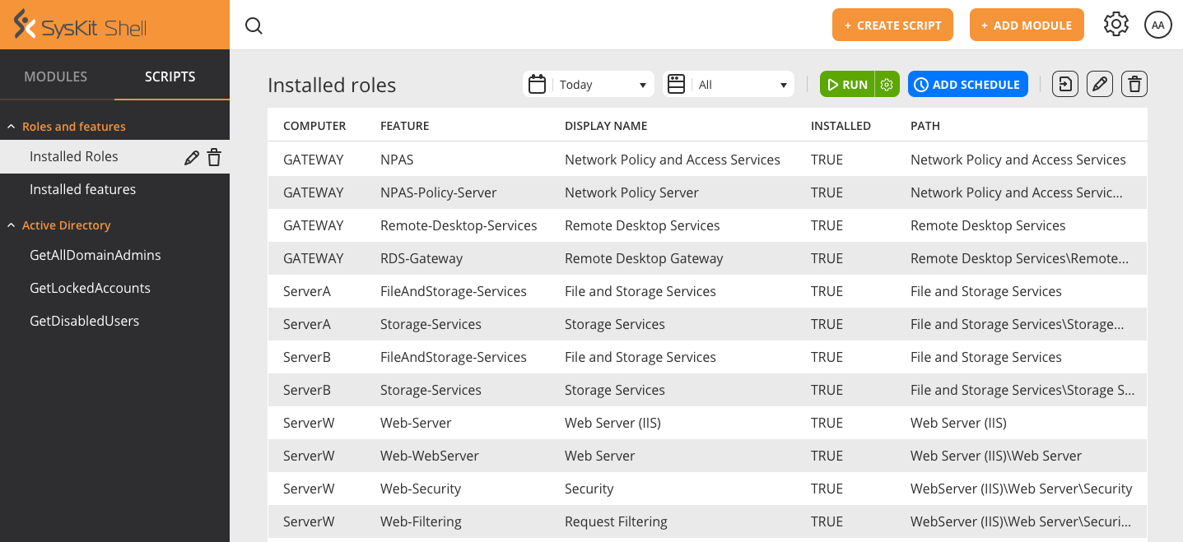
Execute PowerShell scripts using automatic scheduler
Run Scripts on multiple servers simultaneously
Get email alerts after script execution
Add your own servers using Server Manager dialog
Create structured history reports and have all results in one place
https://www.syskit.com/products/shell/

Slide 7
Agenda
Tools
AutoSPInstaller
Commandlets
Modules + Gallery
DSC
PnP PowerShell

Slide 8
PowerShell…
???
Did some scripts
Expert User
Guru

Slide 9
Tools
PowerShell Shell
SharePoint 2016 Management Shell
Visual Studio Code https://code.visualstudio.com/

Slide 10
PowerShell 101
Demo 1

Slide 11
Commandlets

Slide 12
Available commandlets
Access Service cmdlets in SharePoint Server 2016
Administer and configure search in SharePoint Server 2016
Administer security in SharePoint Server 2016
App Management Service cmdlets in SharePoint Server 2016
Backup and recovery cmdlets in SharePoint Server 2016
Database cmdlets in SharePoint Server 2016
Enterprise content management cmdlets in SharePoint Server 2016
Farm cmdlets in SharePoint Server 2016
Features and solutions cmdlets in SharePoint Server 2016
Health monitoring cmdlets in SharePoint Server 2016
Import and export cmdlets in SharePoint Server 2016
InfoPath Services cmdlets in SharePoint Server 2016
Logging and events cmdlets in SharePoint Server 2016
Machine Translation Service applications in SharePoint Server 2016
Manage performance in SharePoint Server 2016
Manage sites in SharePoint Server 2016
Manage timer jobs in SharePoint Server 2016
Managed metadata cmdlets in SharePoint Server 2016
PerformancePoint Services cmdlets in SharePoint Server 2016
Secure Store Service cmdlets in SharePoint Server 2016
Service application cmdlets in SharePoint Server 2016
Site collection cmdlets in SharePoint Server 2016
State service and session state cmdlets in SharePoint Server 2016
Upgrade to SharePoint Server 2016
Use Windows PowerShell cmdlets to administer SharePoint Server 2016
Use Windows PowerShell cmdlets to manage Business Connectivity Services in SharePoint Server 2016
User licenses in SharePoint Server 2016
User Profile service in SharePoint Server 2016
Visio Graphics Services cmdlets in SharePoint Server 2016
Web application cmdlets in SharePoint Server 2016
Word Services cmdlets in SharePoint Server 2016

Slide 13
Commandlets
Demo 2A

Slide 14
Functions
Demo 2B

Slide 15
Modules and PowerShell gallery
A module is a set of related Windows PowerShell functionalities, grouped together as a convenient unit (usually saved in a single directory).
https://www.powershellgallery.com

Slide 16
Modules
Demo 3

Slide 17
AutoSPInstaller
Automated SharePoint 2010/2013/2016 PowerShell-based installation script.
Code: https://github.com/brianlala/AutoSPInstaller
GUI: https://autospinstaller.com/

Slide 18
AutoSPInstaller
Awesome community project!!! (Brian Lalancette and team)
Open-source project – set of PowerShell scripts
Installs SharePoint and performs a base configuration
Single server or multiple-server farms
Input parameter is XML farm file (contains farm topology & details about your farm)
Deployment time reduced, reusable components, create identical production and staging/test environments
https://github.com/brianlala/AutoSPInstaller

Slide 19
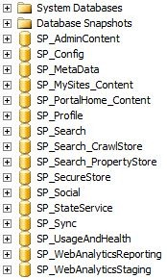
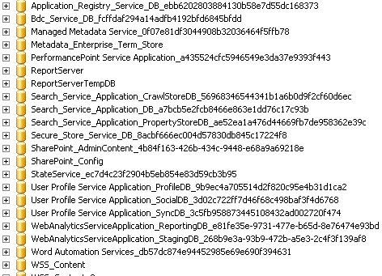
AutoSPInstaller Quick Overview (2)
With AutoSPInstaller
Without AutoSPInstaller

Slide 20
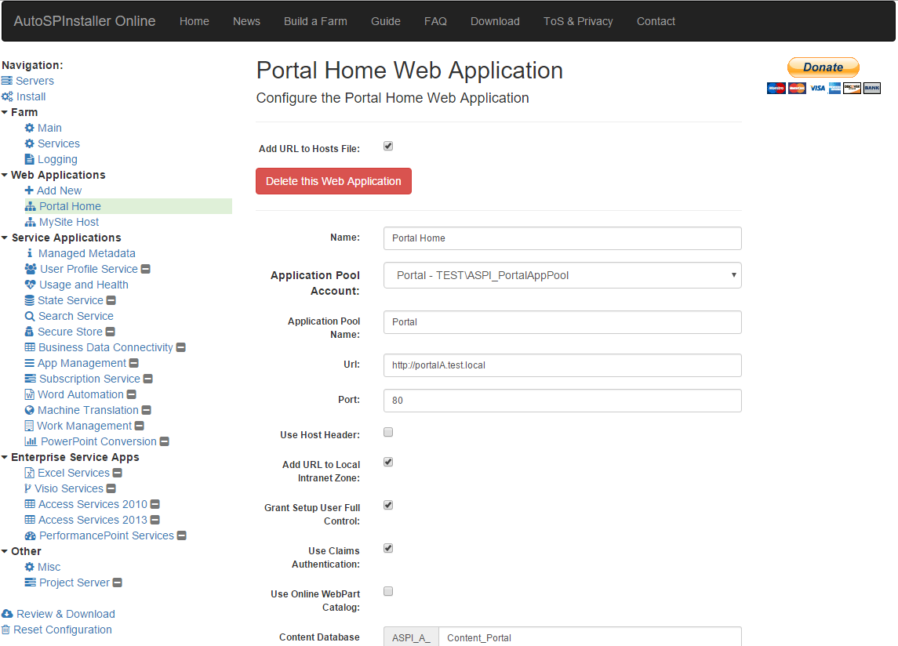
AutoSPInstaller GUI
Windows application - helps build configuration XML file
Provides an interface for editing the XML file with tooltips, tabular GUI, and error checking on the inputs
https://autospinstaller.com/

Slide 21
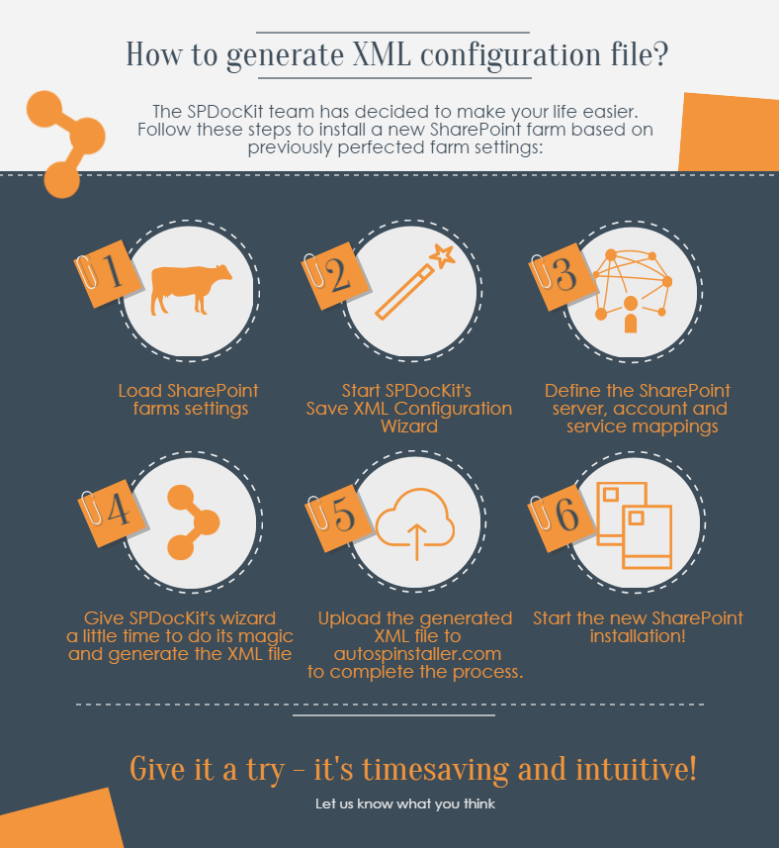
AutoSPInstaller + SPDocKit
Saves current farm setup to an XML configuration file – used as an AutoSPInstaller input file
Make changes to any parameter of XML file
The easiest way to create a new SharePoint farm that is same or similar to your current farm environment
Set up a TEST based on your current DEV, add a new QA or UAT environments with minor changes, it’s up to you!

Slide 22
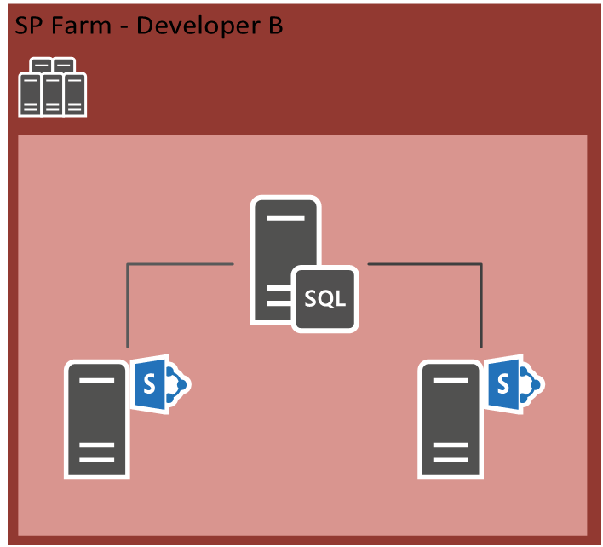
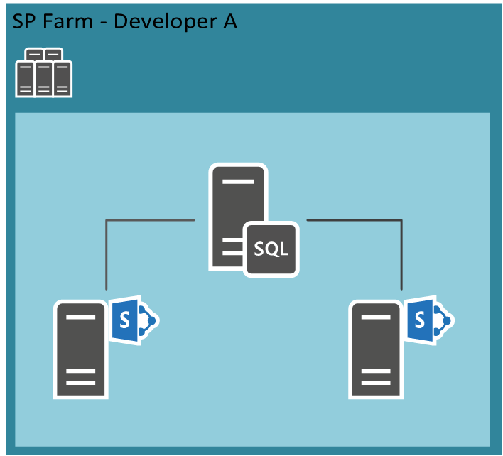
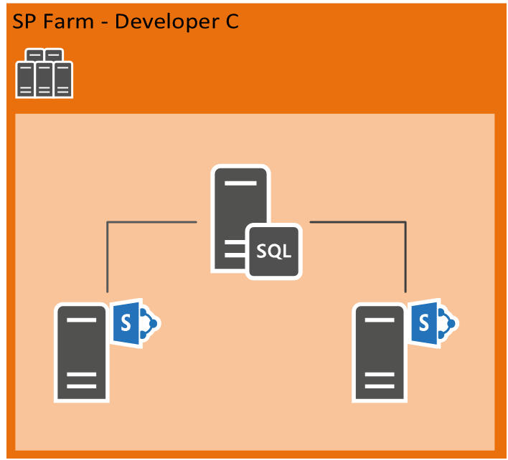
Use Case SPDocKit AutoSPInstaller Wizard

Slide 23
AutoSPInstaller
Demo 4

Slide 24
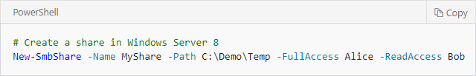
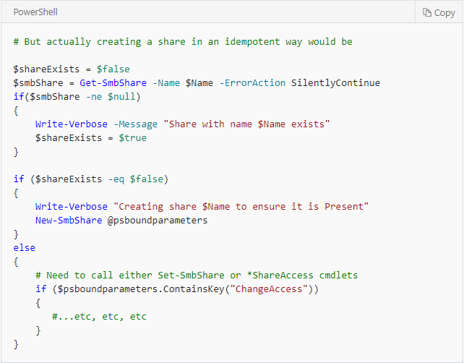
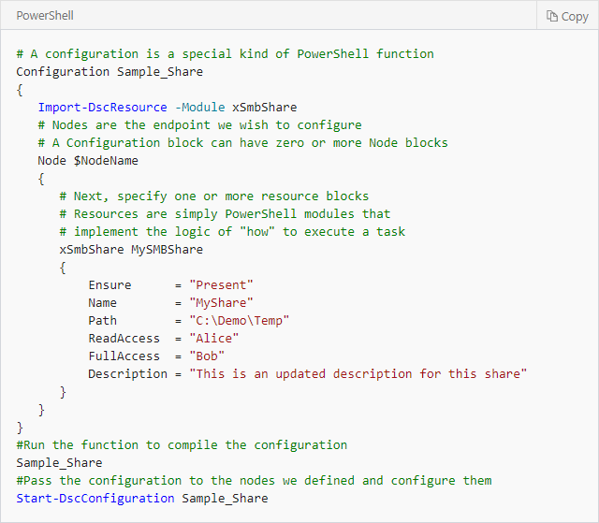
SharePoint DSC - enables configuration as code

Slide 25
SharePoint DSC
Demo 5A

Slide 26
SharePoint DSC Reverse
Demo 5B

Slide 27
PnP PowerShell
SharePoint Patterns and Practices (PnP) contains a library of PowerShell commands (PnP PowerShell) that allows you to perform complex provisioning and artifact management actions towards SharePoint. The commands use CSOM and can work against both SharePoint Online as SharePoint On-Premises.
https://msdn.microsoft.com/en-us/pnp_powershell/pnp-powershell-overview
SharePoint Version | Command to install
SharePoint Online | Install-Module SharePointPnPPowerShellOnline
SharePoint 2016 | Install-Module SharePointPnPPowerShell2016
SharePoint 2013 | Install-Module SharePointPnPPowerShell2013

Slide 28
PnP PowerShell Areas
Apps
Base Cmdlets
Branding
Client-Side Pages
Content Types
Document Sets
Event Receivers
Features
Fields
Files and Folders
Information Management
Lists
Microsoft Graph
Provisioning
Publishing
Records Management
Search
SharePoint Recycle Bin
SharePoint WebHooks
Sites
Taxonomy
Tenant Administration
User and group management
User Profiles
Utilities
Web Parts
Webs
Workflows
https://msdn.microsoft.com/en-us/pnp_powershell/pnp-powershell-overview

Slide 29
PnP PowerShell
Demo 6

Slide 30


Slide 31
Q&A
https://github.com/tonifrankola/sps-paris-powershell

Slide 32

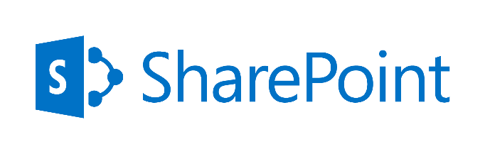


Thank you, for your for #SPSParis

